Slide 1

Time Series
MTH 564 – Mathematical Modeling

Slide 2

Problem
Adjustable-rate mortgages on private homes are commonly based on one of several market indices tabulated by the federal home loan bank. The author’s mortgage is adjusted yearly on the basis of the U.S. Treasury one-year Constant Maturity (CM1) index for May of each year. Historical data for the three-year period beginning June 1986 are shown in Table 8.1. Use this information to project the estimated value of this index in May 1990, the date of the next adjustment.

Slide 3
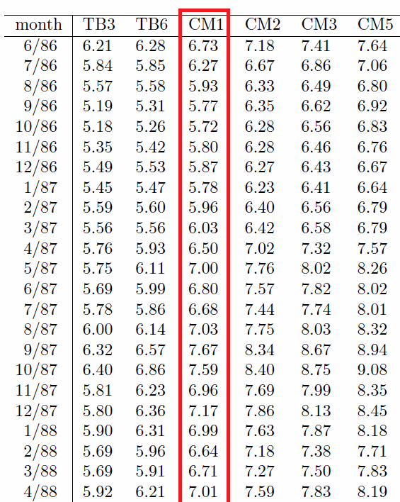
Data
The data can be found in the file cm1.csv
csv – comma separated values
We read the data into Python using the python panda package and the command read_csv
see linear_regression.py

Slide 4
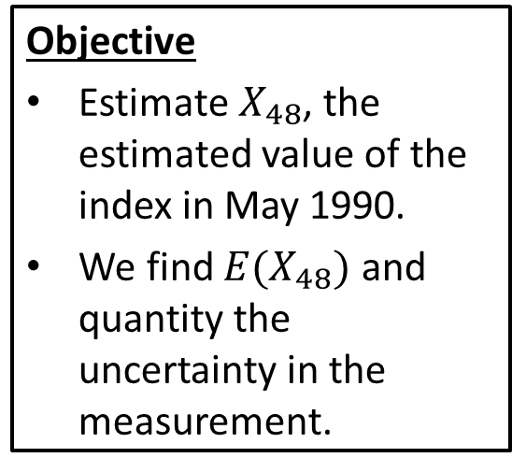
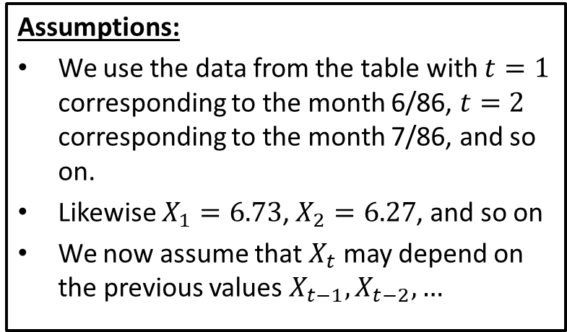
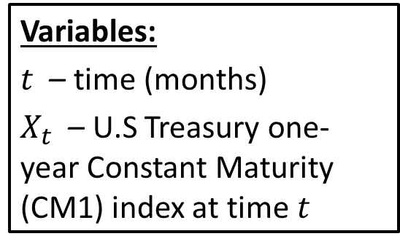
Step 1: Frame the problem
Variables:
$t$ – time (months)
$X_{t}$ – U.S Treasury one-year Constant Maturity (CM1) index at time $t$
Assumptions:
We use the data from the table with $t=1$ corresponding to the month 6/86, $t=2$ corresponding to the month 7/86, and so on.
Likewise $X_{1}=6.73$, $X_{2}=6.27$, and so on
We now assume that $X_{t}$ may depend on the previous values $X_{t−1}, X_{t−2}, …$
Objective
Estimate $X_{48}$, the estimated value of the index in May 1990.
We find $E(X_{48})$ and quantity the uncertainty in the measurement.

Slide 5
Step 2: Select the modeling approach
Variables:
$t$ – time (months)
$X_{t}$ – U.S Treasury one-year Constant Maturity (CM1) index at time $t$
Assumptions:
We use the data from the table with $t=1$ corresponding to the month 6/86, $t=2$ corresponding to the month 7/86, and so on.
Likewise $X_{1}=6.73$, $X_{2}=6.27$, and so on
We now assume that $X_{t}$ may depend on the previous values $X_{t−1}, X_{t−2}, …$
Objective
Estimate $X_{48}$, the estimated value of the index in May 1990.
We find $E(X_{48})$ and quantity the uncertainty in the measurement.
We model this problem using a time series and fit an autoregressive model.

Slide 6
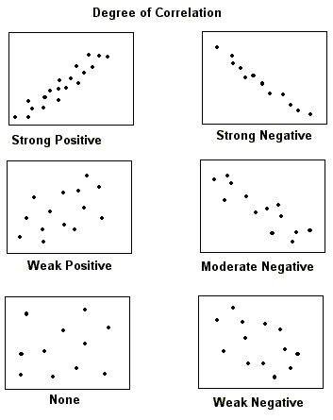
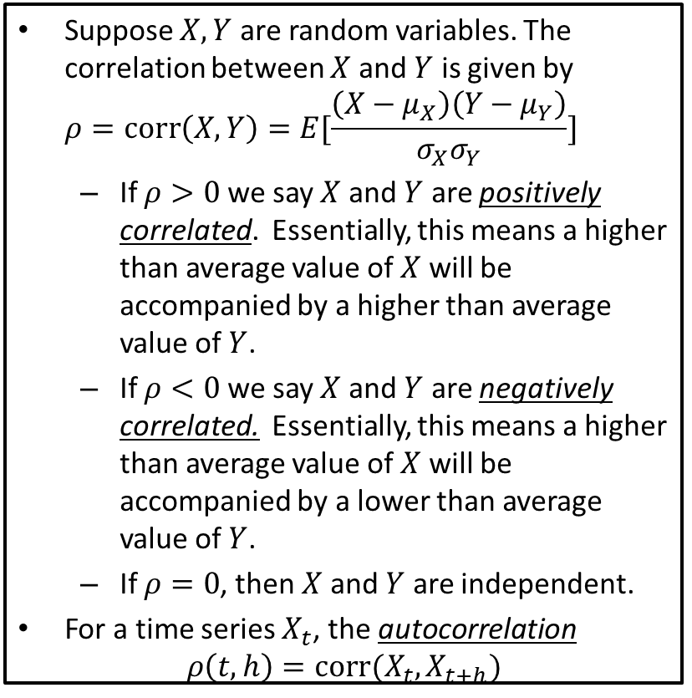
Correlation
Suppose $X,Y$ are random variables. The correlation between $X$ and $Y$ is given by $ρ=corr\left(X,Y\right)=E[\frac{\left(X−μ_{X}\right)\left(Y−μ_{Y}\right)}{σ_{X}σ_{Y}}]$
If $ρ>0$ we say $X$ and $Y$ are positively correlated. Essentially, this means a higher than average value of $X$ will be accompanied by a higher than average value of $Y$.
If $ρ<0$ we say $X$ and $Y$ are negatively correlated. Essentially, this means a higher than average value of $X$ will be accompanied by a lower than average value of $Y$.
If $ρ=0$, then $X$ and $Y$ are independent.
For a time series $X_{t}$, the autocorrelation $ρ\left(t,h\right)=corr(X_{t},X_{t+h})$

Slide 7
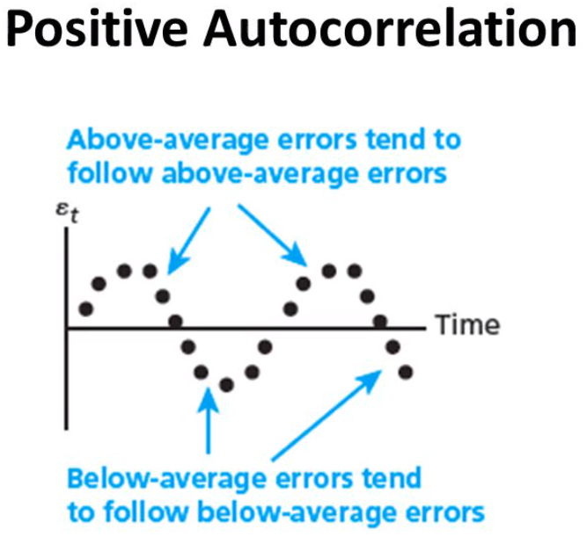
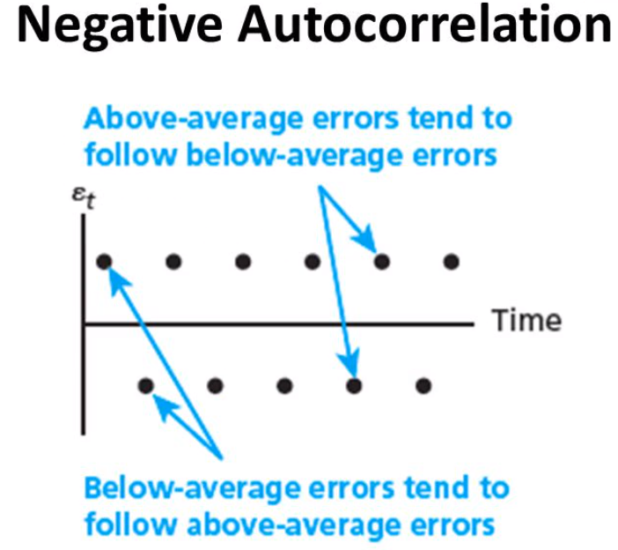

Autocorrelation
For a time series $X_{t}$, the autocorrelation $ρ\left(t,h\right)=corr(X_{t},X_{t+h})$
This function measures dependence between the time series at different times.
A time series is called stationary if the mean $E(X_{t})$ and the autocorrelation function are constant over time.
Notes:
Snake pattern vs. zig/zag pattern

Slide 8
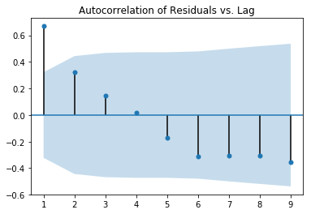

Autoregressive Process (AR)
The simplest useful model is called the autoregressive process model assumes that $X_{t}=a+bt+c_{1}X_{t−1}+c_{2}X_{t−2}+⋯+c_{p}X_{t−p}+ ε_{t}$ where we have also included the trend.
The parameter $p$ is called the order of the autoregressive process, sometimes abbreviated as $AR(p)$.
We use the autoregressive function of the residuals $ρ\left(t,h\right)=corr\left(ε_{t},ε_{t−1}\right)$ We then compare this to the likely values of the autocorrelation function in the case of a noise sequence. Values that indicate something more than noise should be used in the model.
Since the autocorrelation function assumes a stationary process, it is also advisable to check for this using graphical displays (scatter plots) of the residuals.

Slide 9
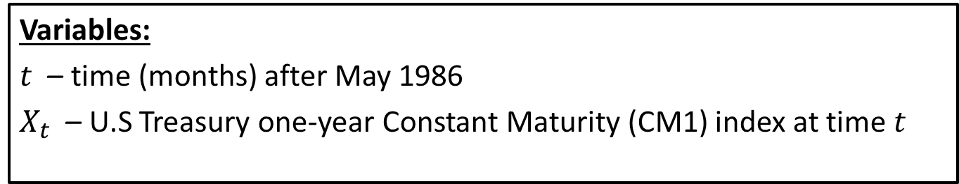
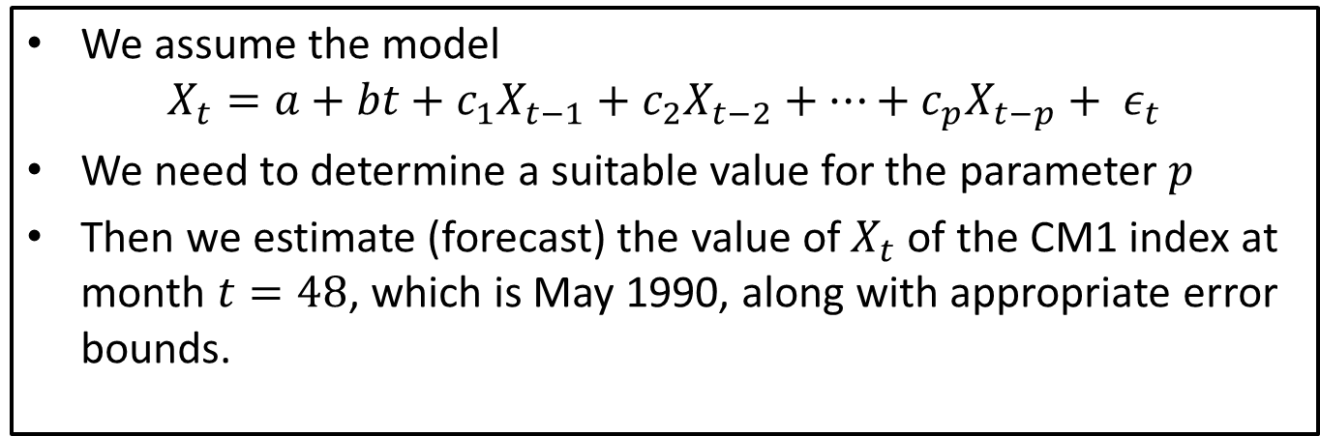
Step 3: Formulate the model
Variables:
$t$ – time (months) after May 1986
$X_{t}$ – U.S Treasury one-year Constant Maturity (CM1) index at time $t$
We assume the model $X_{t}=a+bt+c_{1}X_{t−1}+c_{2}X_{t−2}+⋯+c_{p}X_{t−p}+ ε_{t}$
We need to determine a suitable value for the parameter $p$
Then we estimate (forecast) the value of $X_{t}$ of the CM1 index at month $t=48$, which is May 1990, along with appropriate error bounds.

Slide 10
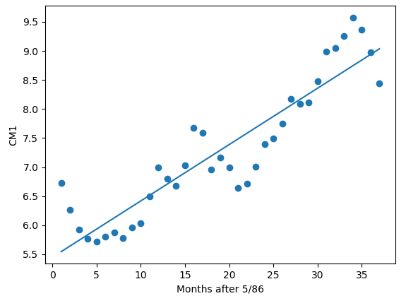
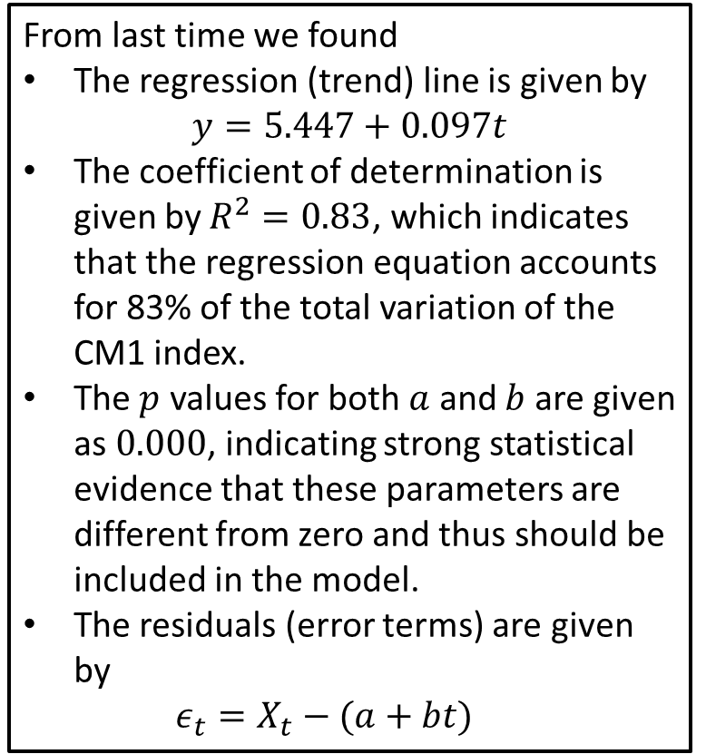
Step 4: Solve the Problem
From last time we found
The regression (trend) line is given by $y=5.447+0.097t$
The coefficient of determination is given by $R^{2}=0.83$, which indicates that the regression equation accounts for 83% of the total variation of the CM1 index.
The $p$ values for both $a$ and $b$ are given as $0.000$, indicating strong statistical evidence that these parameters are different from zero and thus should be included in the model.
The residuals (error terms) are given by $ε_{t}=X_{t}−(a+bt)$

Slide 11
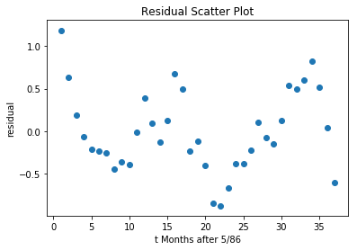
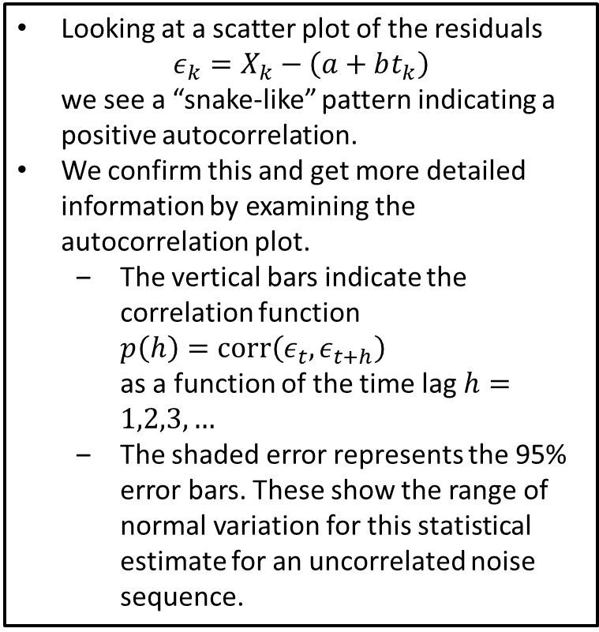
Step 4: Solve the Problem
Looking at a scatter plot of the residuals $ε_{k}=X_{k}−\left(a+bt_{k}\right)$ we see a “snake-like” pattern indicating a positive autocorrelation.
We confirm this and get more detailed information by examining the autocorrelation plot.
The vertical bars indicate the correlation function $p\left(h\right)=corr\left(ε_{t},ε_{t+h}\right)$ as a function of the time lag $h=1,2,3,…$
The shaded error represents the 95% error bars. These show the range of normal variation for this statistical estimate for an uncorrelated noise sequence.

Slide 12
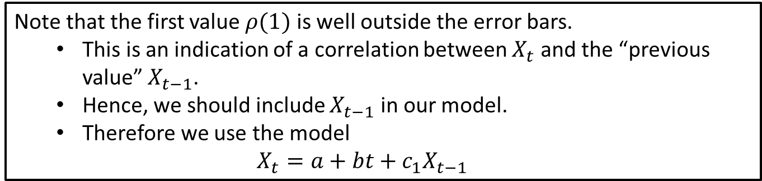
Step 4: Solve the Problem
Note that the first value $ρ(1)$ is well outside the error bars.
This is an indication of a correlation between $X_{t}$ and the “previous value” $X_{t−1}$.
Hence, we should include $X_{t−1}$ in our model.
Therefore we use the model $X_{t}=a+bt+c_{1}X_{t−1}$

Slide 13
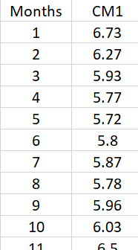
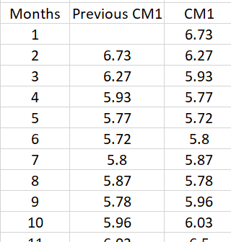
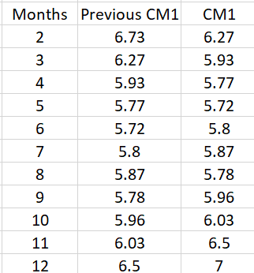
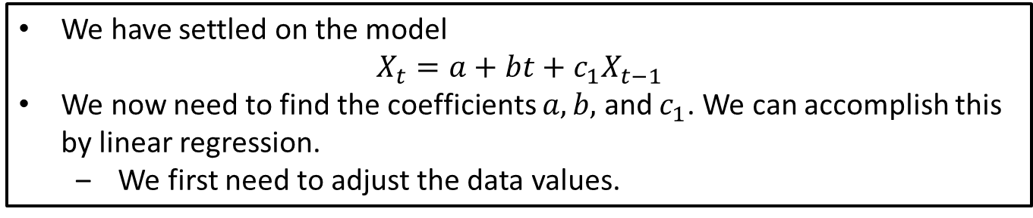
Step 4: Solve the Problem
We have settled on the model $X_{t}=a+bt+c_{1}X_{t−1}$
We now need to find the coefficients $a, b,$ and $c_{1}$. We can accomplish this by linear regression.
We first need to adjust the data values.
Original
Add Predictor (Previous Data)
Throw Out 1st Value

Slide 14
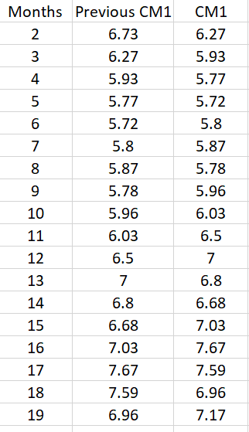
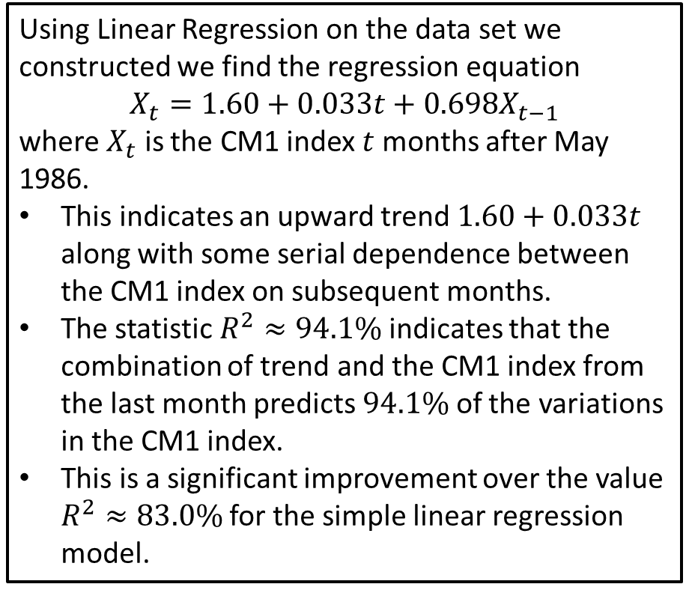
Step 4: Solve the Problem
Using Linear Regression on the data set we constructed we find the regression equation
$$X_{t}=1.60+0.033t+0.698X_{t−1}$$
where $X_{t}$ is the CM1 index $t$ months after May 1986.
This indicates an upward trend $1.60+0.033t$ along with some serial dependence between the CM1 index on subsequent months.
The statistic $R^{2}≈94.1\%$ indicates that the combination of trend and the CM1 index from the last month predicts $94.1\%$ of the variations in the CM1 index.
This is a significant improvement over the value $R^{2}≈83.0\%$ for the simple linear regression model.

Slide 15
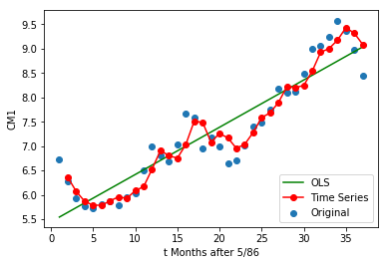
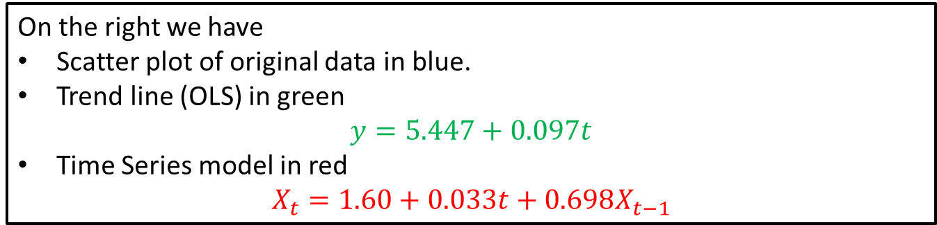
Step 4: Solve the Problem
On the right we have
Scatter plot of original data in blue.
Trend line (OLS) in green $y=5.447+0.097t$
Time Series model in red $X_{t}=1.60+0.033t+0.698X_{t−1}$

Slide 16
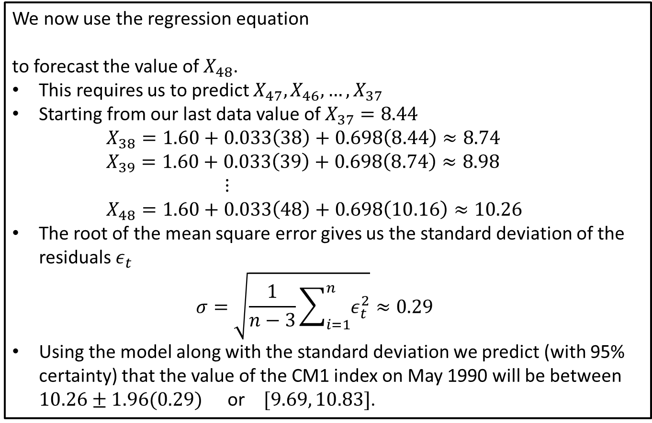
Step 4: Solve the Problem
We now use the regression equation
to forecast the value of $X_{48}$.
This requires us to predict $X_{47}, X_{46},…,X_{37}$
Starting from our last data value of $X_{37}=8.44$ $X_{38}=1.60+0.033\left(38\right)+0.698\left(8.44\right)≈8.74$ $X_{39}=1.60+0.033\left(39\right)+0.698\left(8.74\right)≈8.98$ $⋮$ $X_{48}=1.60+0.033\left(48\right)+0.698\left(10.16\right)≈10.26$
The root of the mean square error gives us the standard deviation of the residuals $ε_{t}$ $σ=\sqrt{\frac{1}{n−3}\sum_{i=1}^{n}{ε_{t}^{2}}}≈0.29$
Using the model along with the standard deviation we predict (with 95% certainty) that the value of the CM1 index on May 1990 will be between $10.26±1.96(0.29)$ or $[9.69, 10.83]$.

Slide 17

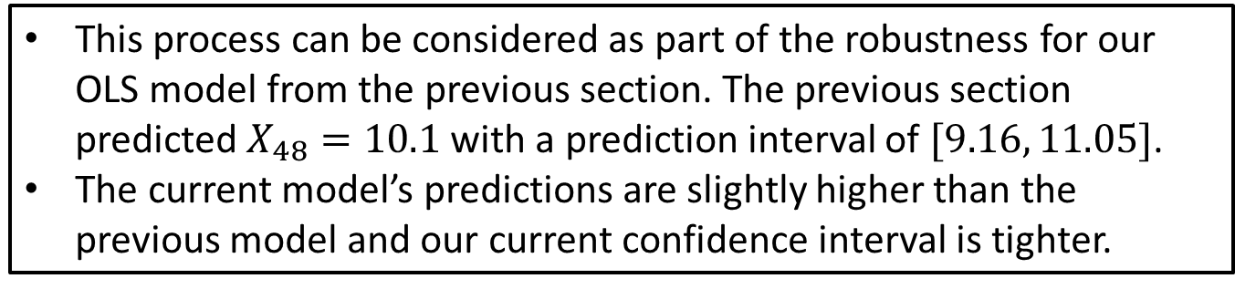
Step 5: Answer the question
We found that a predicted value of
$$X_{48}=10.26$$
along with a confidence interval of $[9.69, 10.83]$.
This process can be considered as part of the robustness for our OLS model from the previous section. The previous section predicted $X_{48}=10.1$ with a prediction interval of $[9.16, 11.05]$.
The current model’s predictions are slightly higher than the previous model and our current confidence interval is tighter.
Putting this all together, we expect that the CM1 index for Mary 1990 is likely to be a bit more than one point higher than the May 1989 value, and we are reasonably sure it will go up by at least ¾ of percent from the May 1989 value of 8.98.

Slide 18
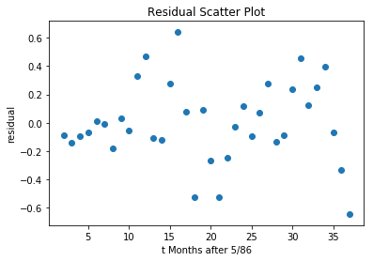
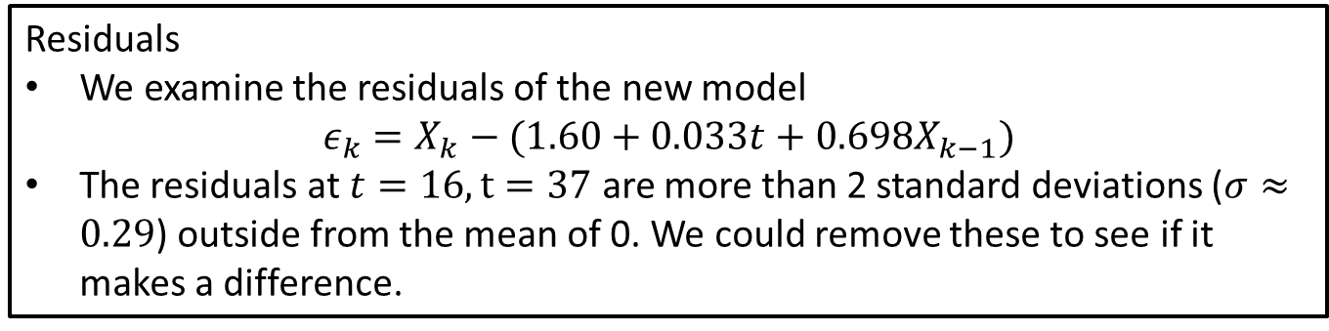
Sensitivity and Robustness Considerations
Residuals
We examine the residuals of the new model $ε_{k}=X_{k}−(1.60+0.033t+0.698X_{k−1})$
The residuals at $t=16, t=37$ are more than 2 standard deviations ($σ≈0.29$) outside from the mean of 0. We could remove these to see if it makes a difference.

Slide 19
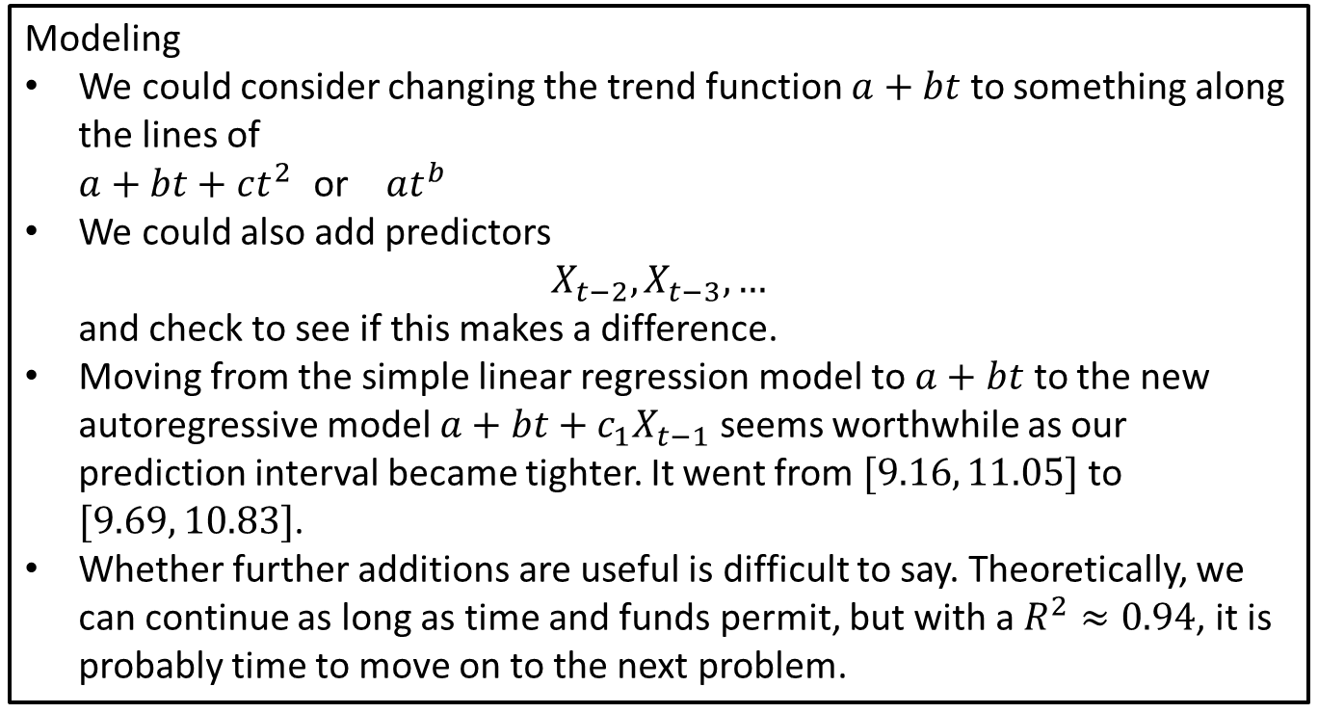
Sensitivity and Robustness Considerations
Modeling
We could consider changing the trend function $a+bt$ to something along the lines of $a+bt+ct^{2}$ or $at^{b}$
We could also add predictors $X_{t−2}, X_{t−3}, …$ and check to see if this makes a difference.
Moving from the simple linear regression model to $a+bt$ to the new autoregressive model $a+bt+c_{1}X_{t−1}$ seems worthwhile as our prediction interval became tighter. It went from $[9.16, 11.05]$ to $[9.69, 10.83]$.
Whether further additions are useful is difficult to say. Theoretically, we can continue as long as time and funds permit, but with a $R^{2}≈0.94$, it is probably time to move on to the next problem.

